Slide 1

COVID -19
Data Tracker
Data Analysis Project
TASK: Web scrapping and Exploratory Data Analysis

Slide 2
AIM
The project is aimed to collect real-time COVID-19 data from various reliable sources using web scraping techniques and perform Exploratory visualization and data exploration for data driven descisoins
( real time insights)

Slide 3
Overview of the Dataset
The dataset used in this analysis contains comprehensive information on COVID-19 Data, including Country,Total cases, Total deaths , critical cases , total recovered cases and more.
TASK:
Web scrapping and Exploratory Data Analysis

Slide 4
Tracking and Analysing COVID 19 Data?
WHY?

Slide 5
Overview of PROJECT
Web Scraping
( Data Sources,Dynamic Websites, Selective Scraping ,Error Handling, Respectful Scraping)
Data cleaning ( RegEx)
Exploratory Data Analysis (EDA)
Time Series Analysis ,Summary Statistics,Visualizations and Draft meaniful insights

Slide 6
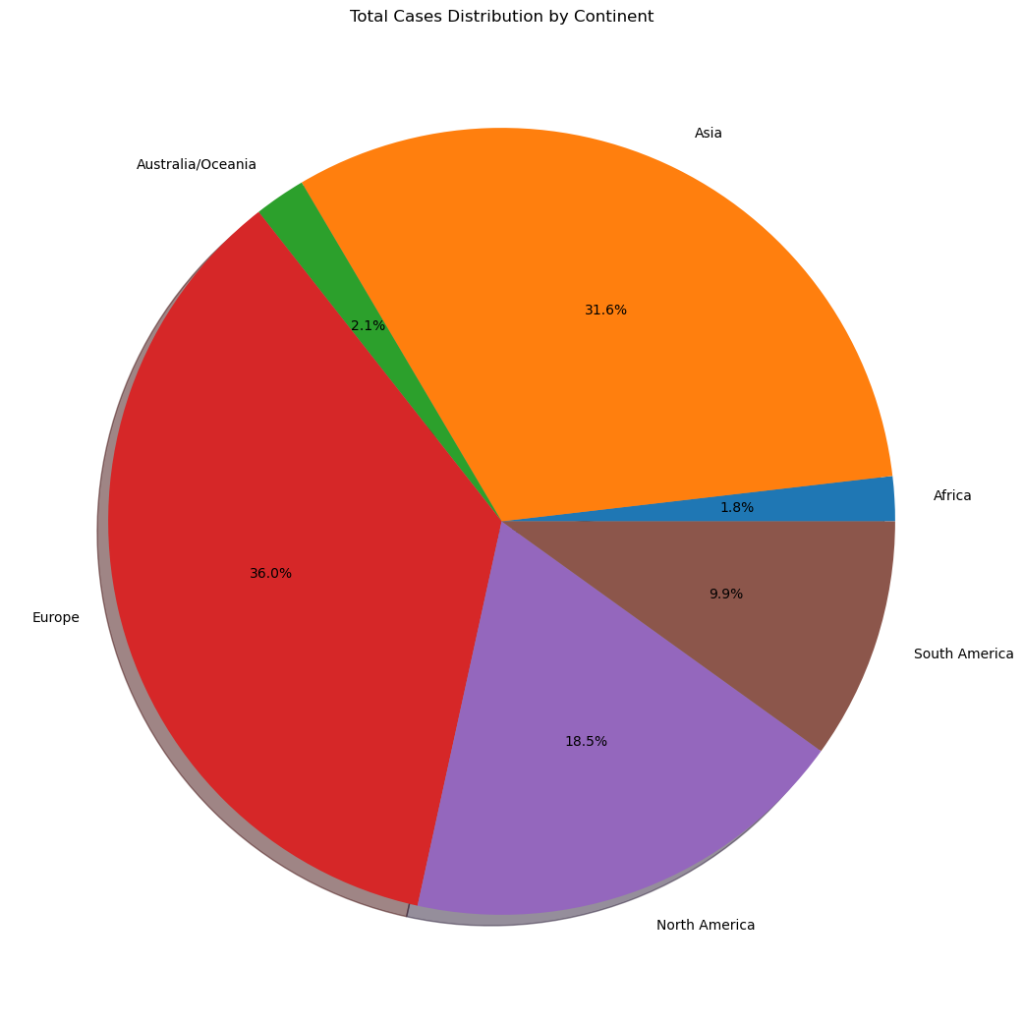
Total cases distribution by Continent
Europe -36.0%
Asia - 31.6%
North America- 18.5%
South America - 9.9%
Australia - 2.1%
Africa - 1.8%

Slide 7
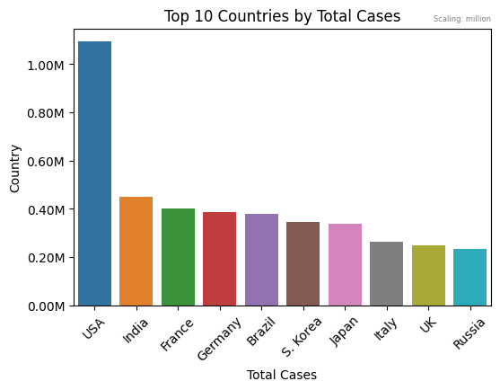
Total cases distribution by Country
Top 10 Countries
USA - has highest cases
Russia -10th position

Slide 8
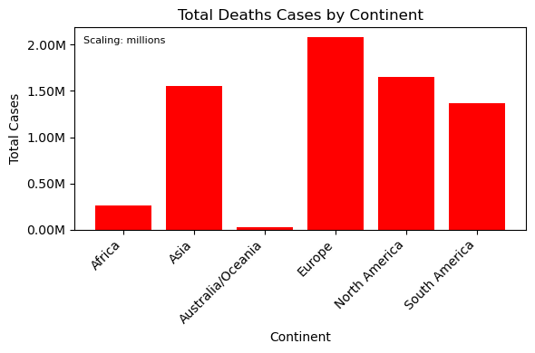
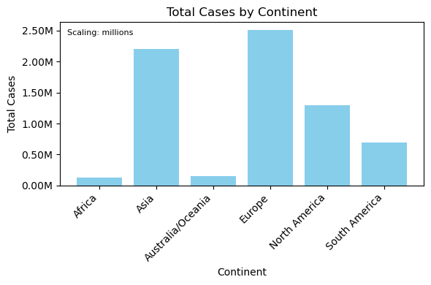
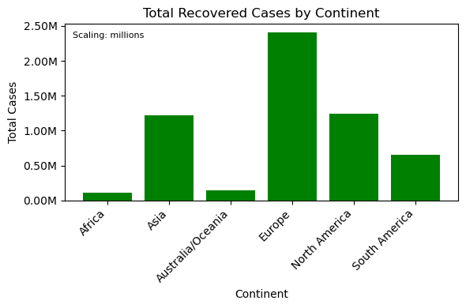
Graphs illustrate Total Cases, Total Death cases and Total Recovered cases by Continent

Slide 9
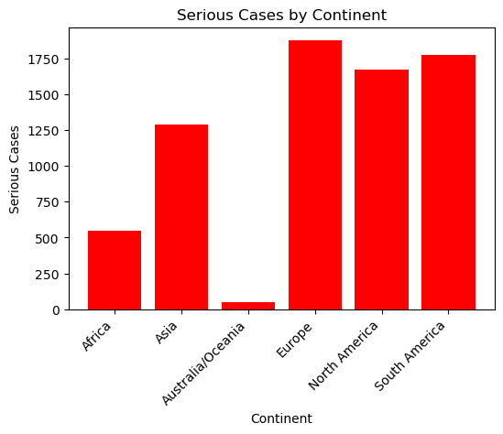
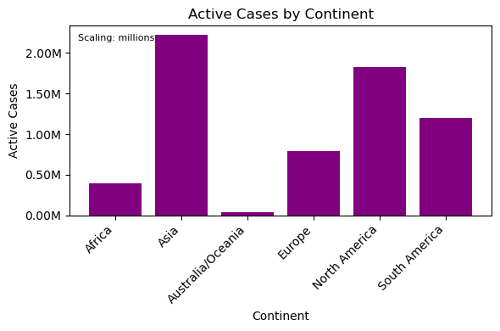
European countries have more critical cases rather than Asia
Asia has more active cases by Continent

Slide 10
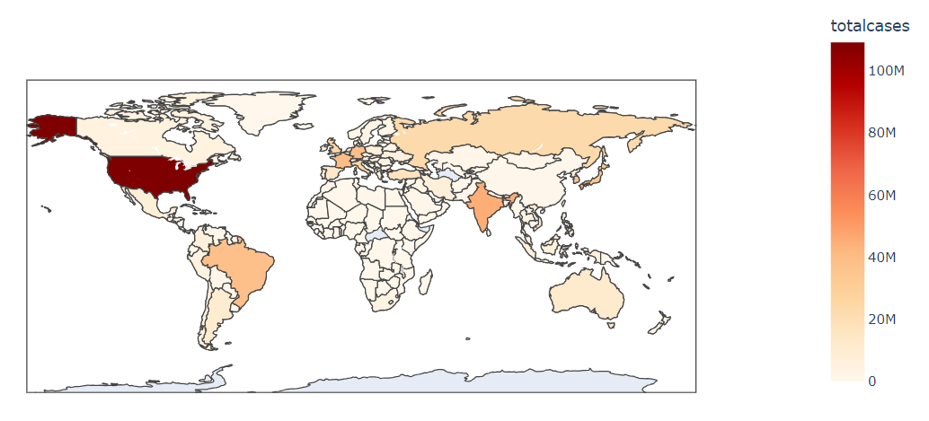
The world map provides a visual representation of how COVID-19 cases are distributed globally
Darker colors represent countries with higher total cases

Slide 11
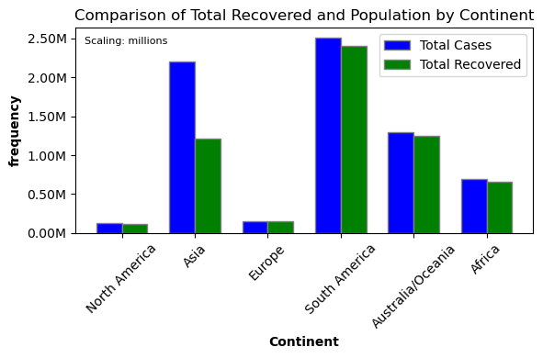
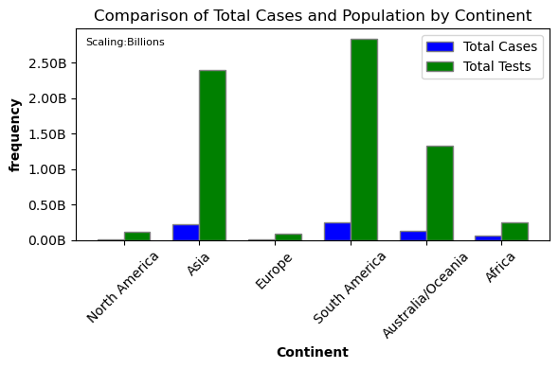
Graphs illustrate comparisons of Total Recovered cases and Total Cases with Total Population

Slide 12
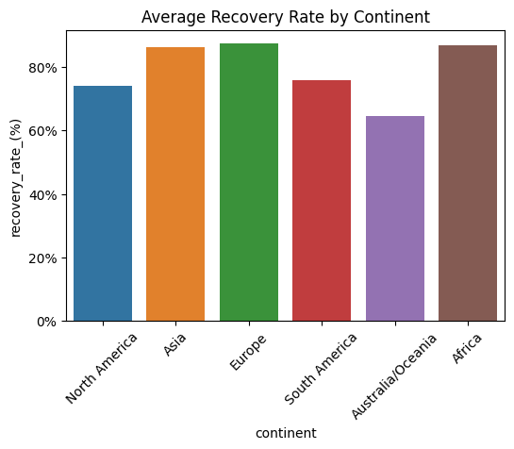
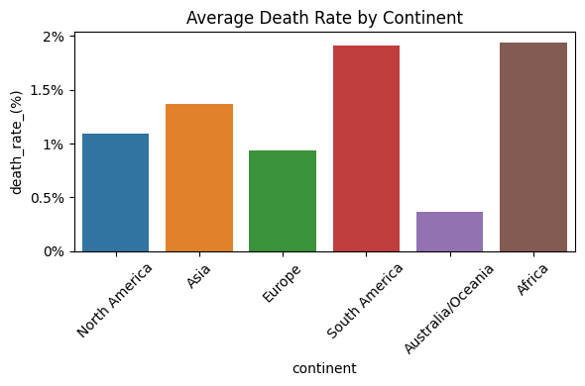
Graphs illustrate comparisons of Average Death Rate and Recovery Rate by Continent

Slide 13
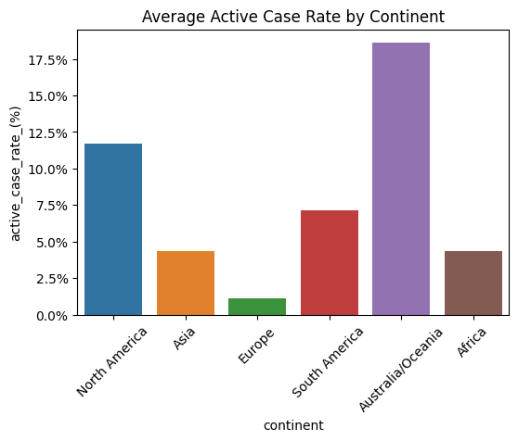
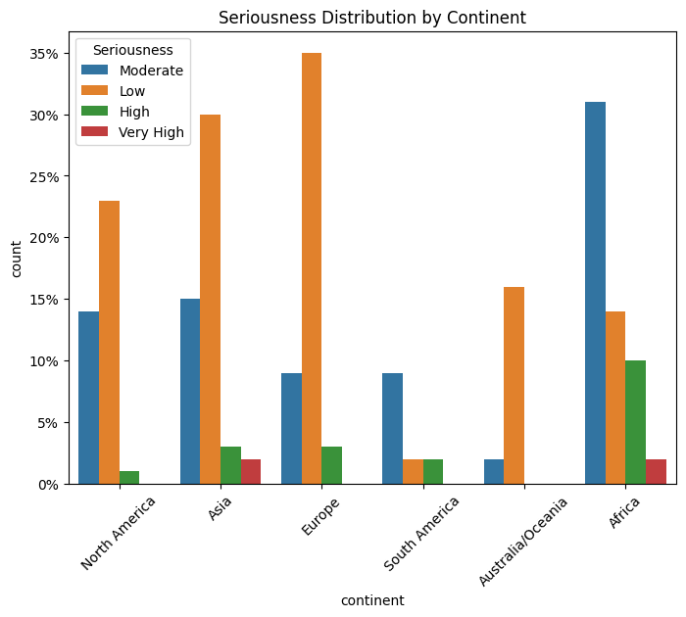
Graph illustrate comparisons of Average Active Case Rate by Continent
Graphs illustrate comparisons of Seriousness Distribution by Continent

Slide 14
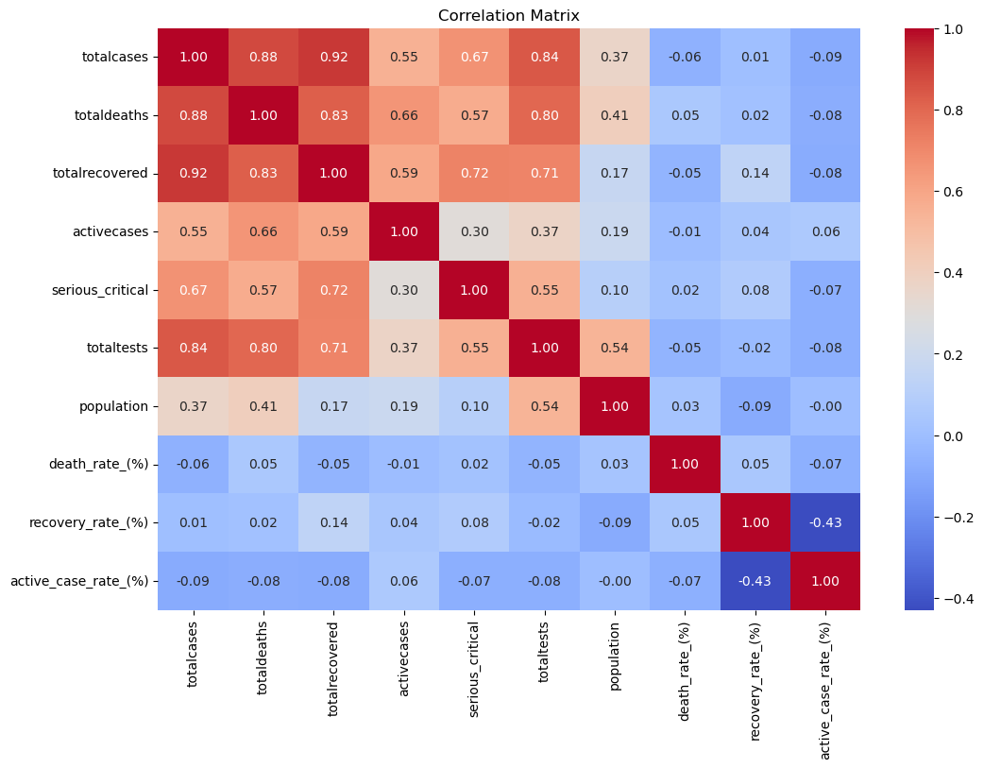
Correlation matrix showing the correlation between different variables
The correlation coefficient is a measure of the strength and direction of the linear relationship between two variables. It can range from -1 to 1, with -1 indicating a perfect negative correlation, 1 indicating a perfect positive correlation, and 0 indicating no correlation.

Slide 15
INSIGHTS
1. The strong correlation between totalcases and totaldeaths suggests that the number of deaths is a good proxy for the severity of the pandemic. This can be used to track the progress of the pandemic and to assess the effectiveness of control measures.
2. The moderate correlation between totalcases and totaltests suggests that increasing the number of tests can help to identify more cases and to track the spread of the virus. This information can be used to inform public health measures, such as contact tracing and isolation.

Slide 16
INSIGHTS
3. The weak correlation between totalcases and population suggests that the size of the population is not a major factor in determining the number of cases. This suggests that control measures should be implemented regardless of the size of the population
4. The negative correlation between the death rate and the recovery rate suggests that the two variables are competing outcomes. This means that interventions that reduce the death rate may also reduce the recovery rate, and vice versa. It is important to balance these two outcomes when developing policies and interventions.

Slide 17
Tracking and Analysing COVID 19 Data
Real-time Insights
Decision-Making Support
Identifying Hotspots and Trends
Public Awareness
Research and Development
Vaccine Distribution and Efficacy
Resource Allocation

Slide 18
Do you have
any questions?
html link of the data set:
https://www.worldometers.info/coronavirus/#google_vignette
THANK YOU

